Slide 1
Fattah Hanafi Portfolio
Fattah Hanafi
2023

Slide 2
My Journey
Education
Associate Degree in Industrial Drafting & Design
Bachelor in Mechanical Engineering
Master in Mechanical Engineering
Experience
3D Drafter/Designer
SolidWorks
AutoCAD
CATIA

Slide 3

3D Drafter/Designer @ Saze Hydraulic
@ Neda Gostar Armin
Draft components in SolidWorks
Applied GD&T
Made design for manufacturing drawings

Slide 4
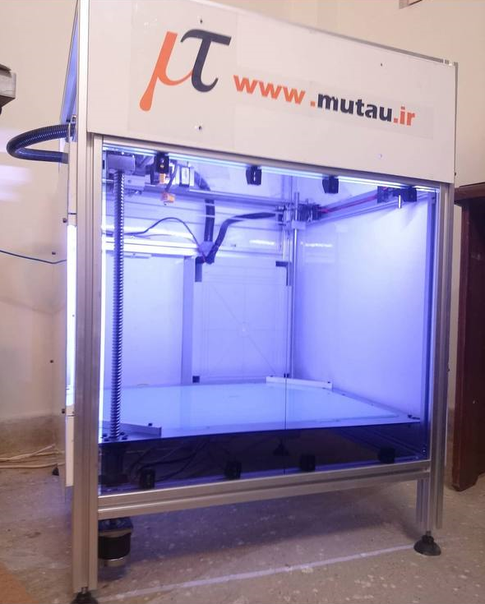
Co-founder @ Mutau Company
Create and manufacture 3D printers customized to specific sizes.
Design the 3D models
Plan the manufacturing process

Slide 5
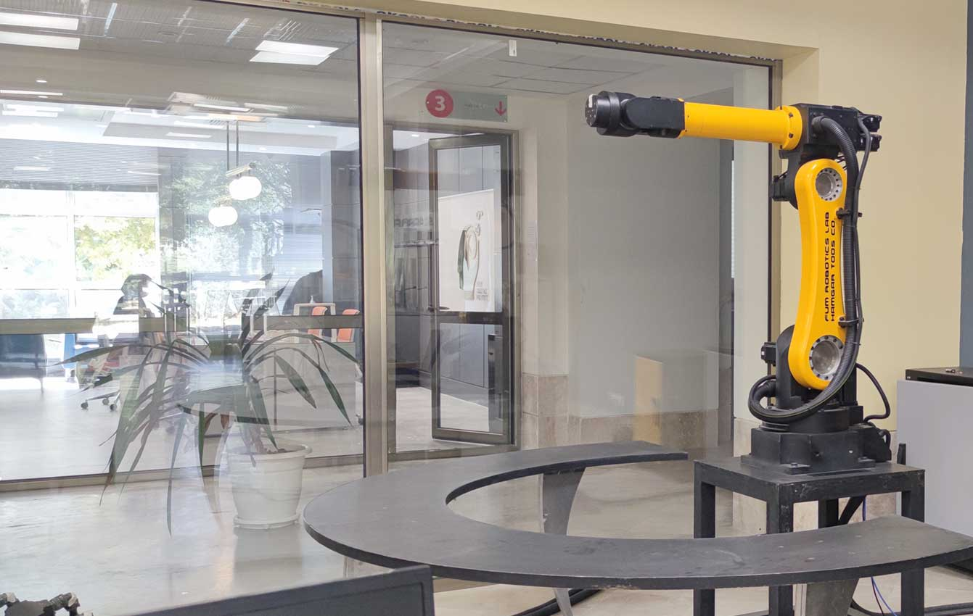
Robotics Team Manager @ FUM Robotics Lab
@ Hamgar Toos
Led a team of ten mechanical and software engineers
Market viability and conduct product research
Design robots for specific applications
Analyze and optimize the product
Select the components of both mechanical and electrical components of the product
Cost management for making product financially viable
Developed a series of 6 different robots

Slide 6
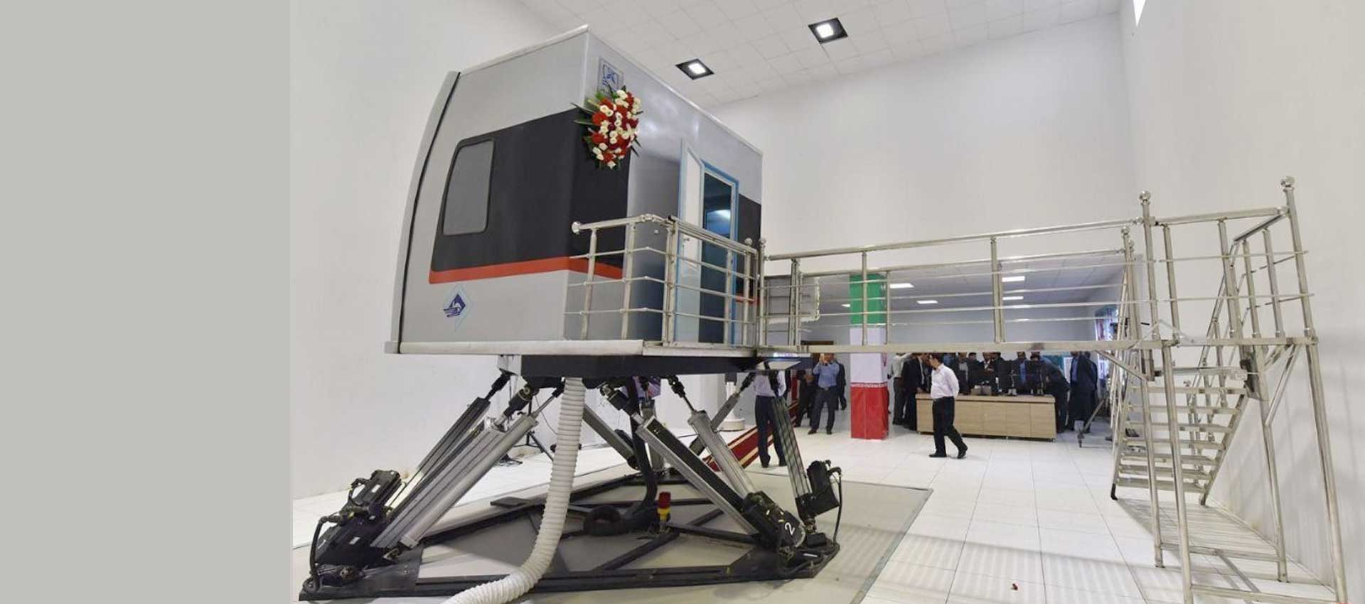
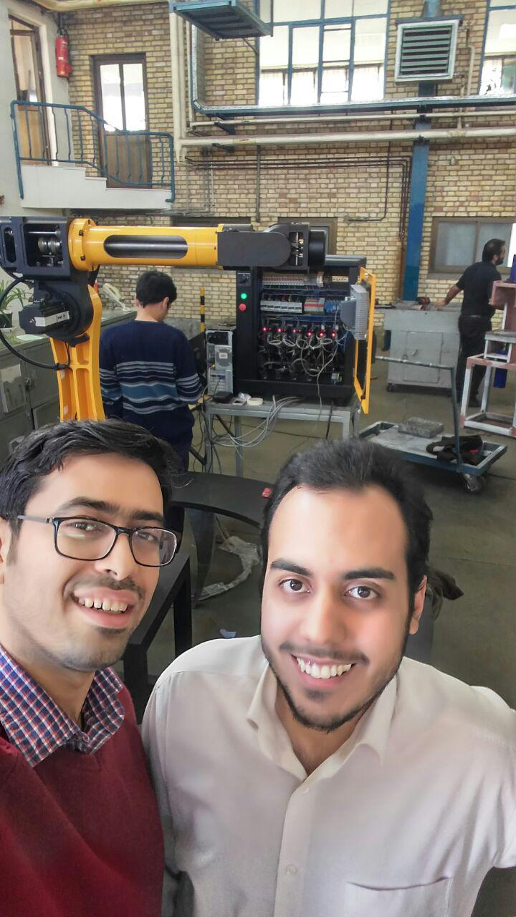
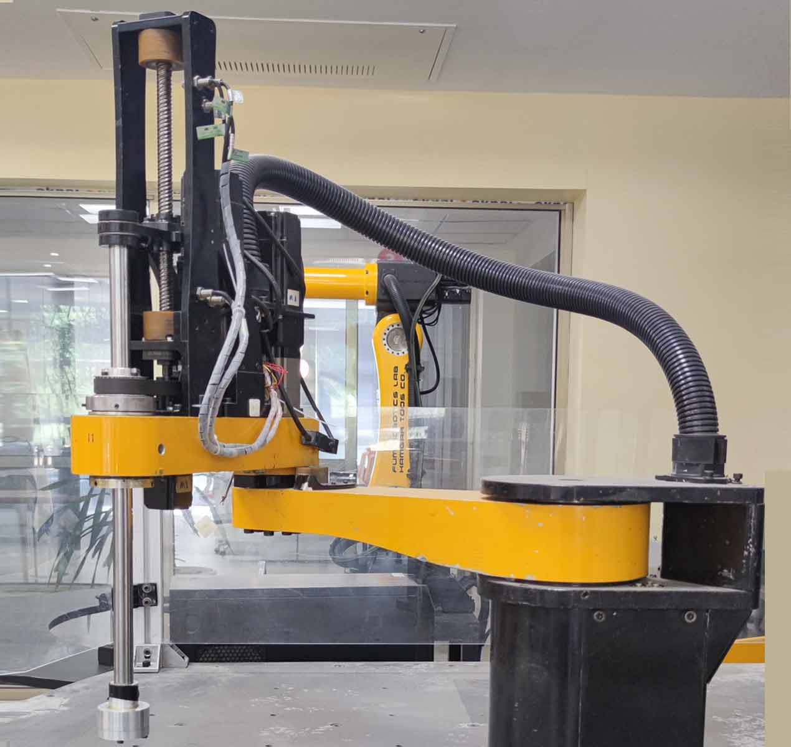
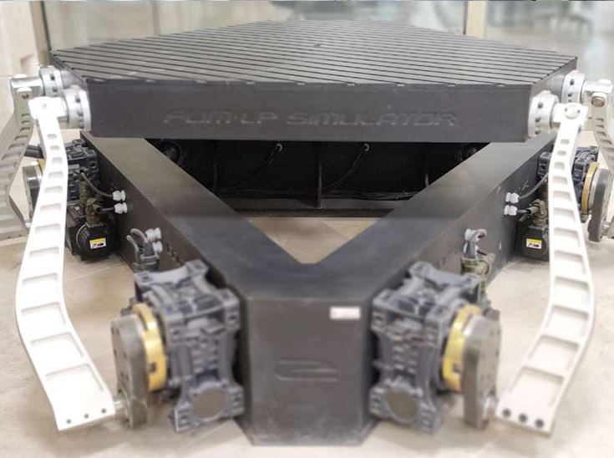
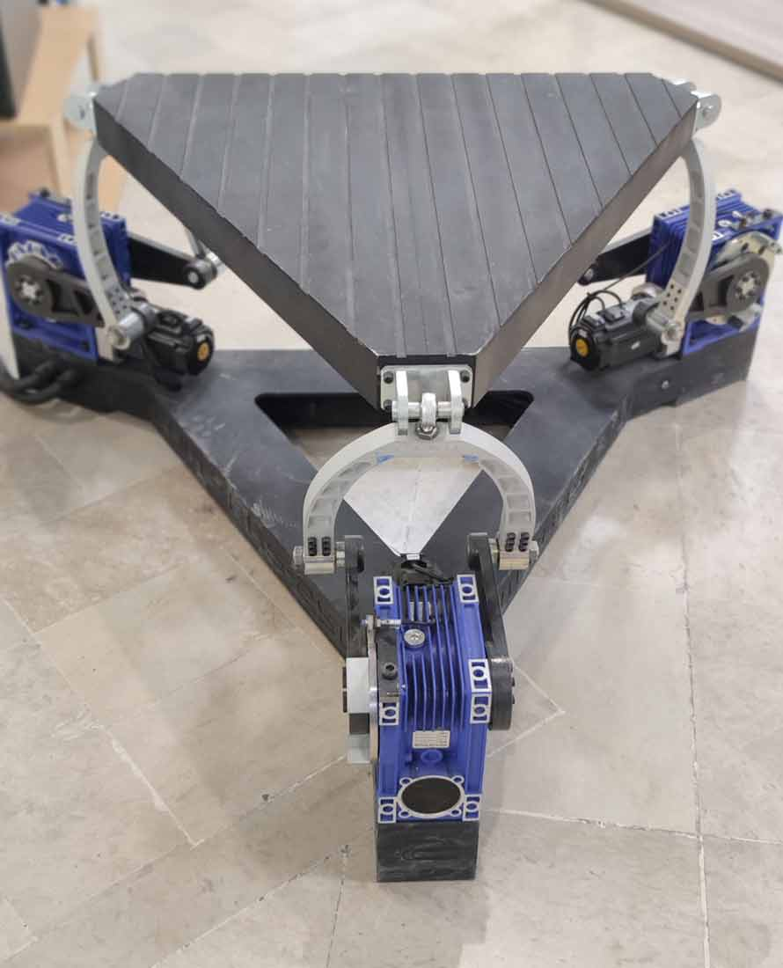
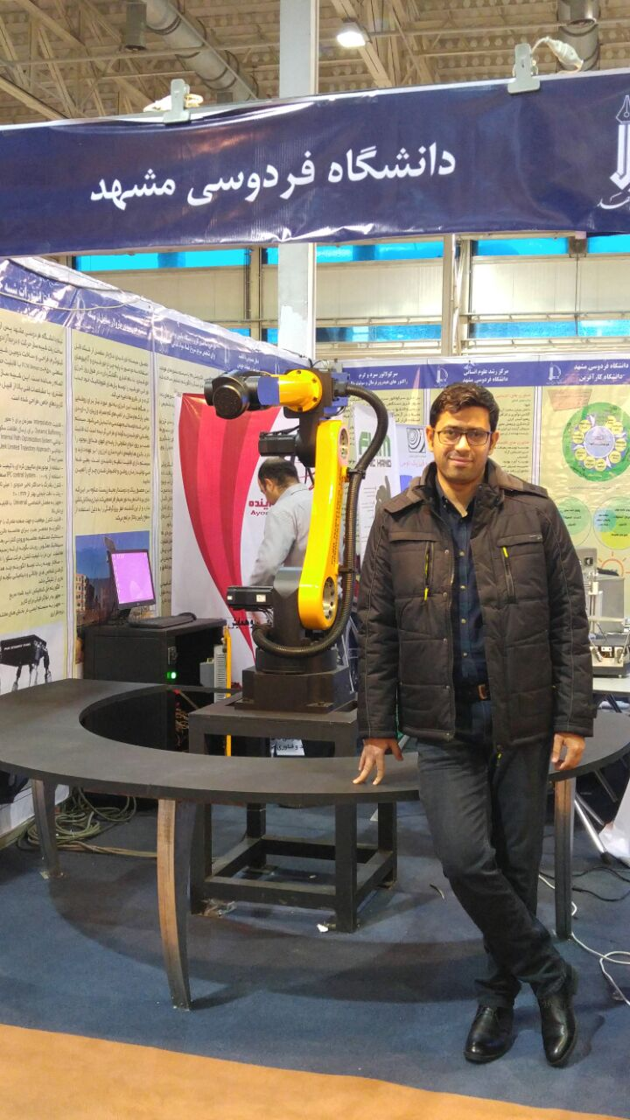
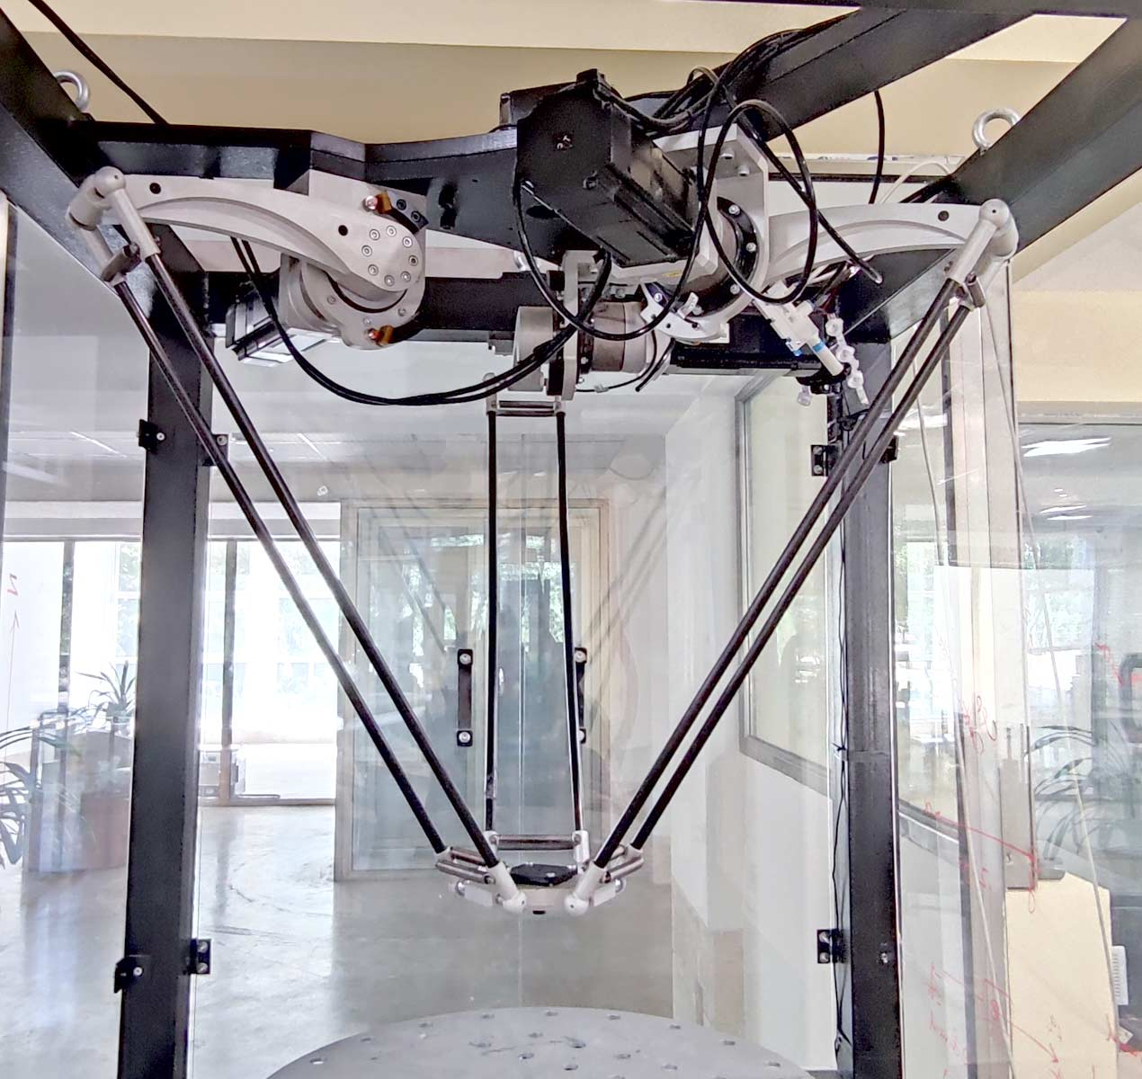

Slide 7
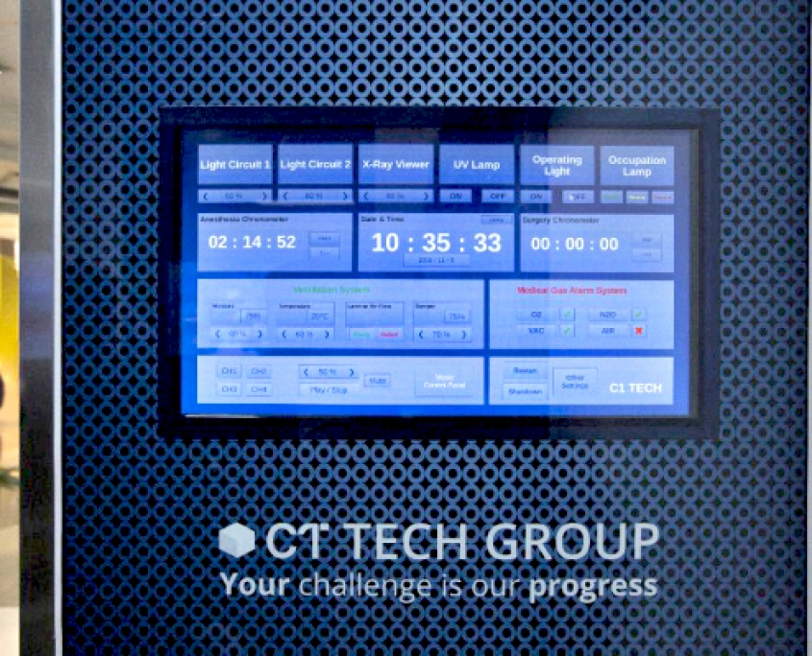
Engineering Team Manager
@ C1-Tech
Designed and developed an automation panel for surgery operation rooms
Compliance with surgical standards
Successfully sold 60 units to 7 hospitals

Slide 8


My Journey
Education
Ph.D. in Mechanical Engineering
Experience
Robotics

Slide 9


My Journey

Slide 10
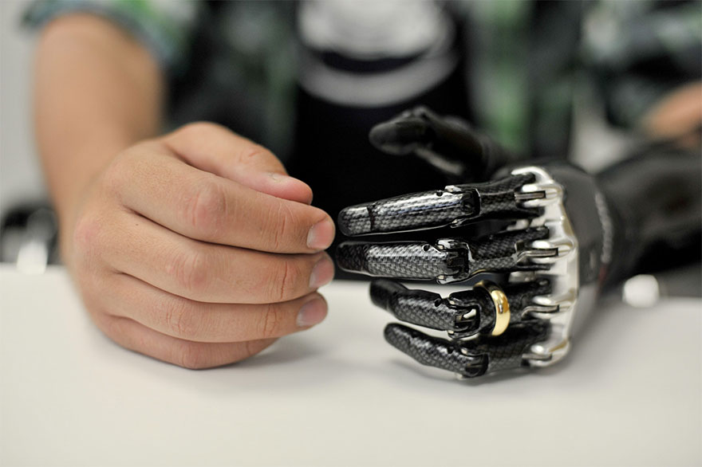
Product Designer @ Medipol University
Develop a prosthetic hand
Designed the model in 3D softwares
Designed as a soft robot in mind
Compliance with EU Medical Devices Regulation

Slide 11

My Journey
Education
Ph.D. in Mechanical Engineering
Experience
Autonomous Excavation
Safety critical equipments
Real-time applications

Slide 12
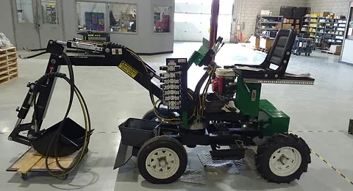
Research Assisstant @ AVEC LAB
Develop autonomous excavator
Real-time application
Construction sites safety standards
Embedded devices

Slide 13

My Future
Education
No more!
Experience
Working on exciting products!

